Slide 1
Predicting the Water Quality of Streams
By
Juan Yostly

Slide 2
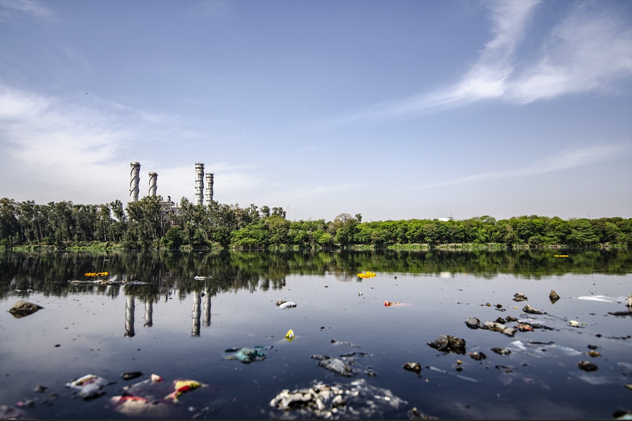

Slide 3
The Problem:
Poor water quality is rarely an isolated incident
Notes:
In 2023, the EPA found that bacteria exceeded the recreational benchmark in 20% of river and stream miles.
It’s no great discovery that water flows into itself. The issues of one part of the harbor are not entirely isolated from the issues of another. By better understanding how this water quality network works, water quality issues can be treated systematically rather than on a case by case basis.
Understanding the system requires constant and broad monitoring which is costly and time consuming.
Is it possible to model reservoirs to predict which components greatly impact water quality

Slide 4
The Solution:
Reduce monitoring costs by reducing number of parameters measured and sites tested.
Notes:
My proposed solution is to use geospatial statistics and machine learning to reduce monitoring costs without sacrificing accuracy
I looked at E coli. because it signals poor water quality that can cause cascading effects damaging the natural ecosystem and public health alike

Slide 5
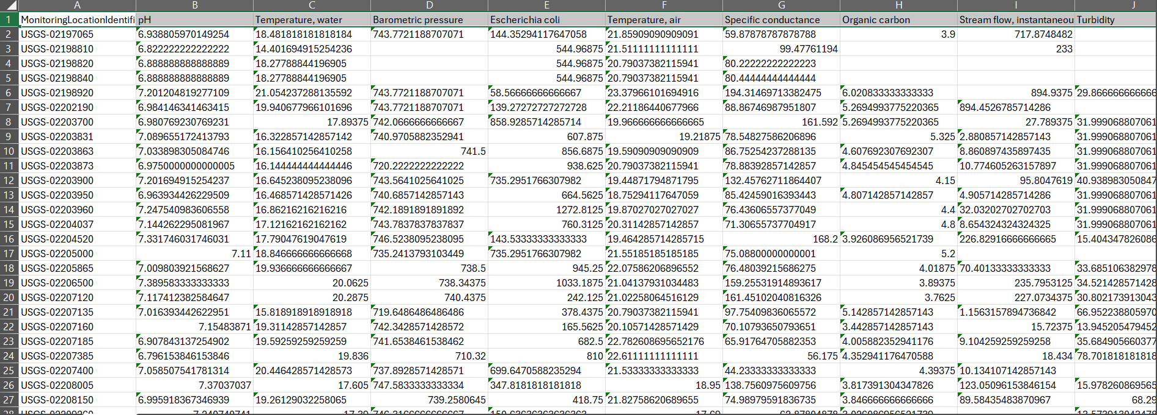
Data Source: https://www.waterqualitydata.us/
Notes:
Dataset was 88,000 rows and 100 columns
Measurements from 1909
250 total sites

Slide 6
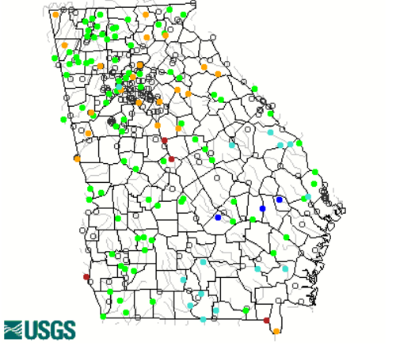
Georgia Water Bodies Sample Sites
Notes:
The dataset I used came from the Georgia EPA
Water samples have been collected from all these sites from as early as 2 years ago

Slide 7
Data Wrangling
Only consider data from Aug 8, 2022 and later
Only consider sites on Georgia map
Drop uncessary columns
Drop rows with more than 30% of data missing
Forward fill blank values with median value over all sites
Target Variable: E. Coli.
Original dataset had ~80,000 rows and 100 columns and not a single complete row
Notes:
Wanted a large enough time span to capture multiple climate anomalies
Wanted to focus on sites actively being sampled
Reduced the size and scope considerably by dumping redundant data
Imputed values based on old measurements and streamflow
Chose e coli as my target vairable because it has far reaching and tangible, immediate effects on an ecosystem such as fish death and drops in dissolved oxygen

Slide 8
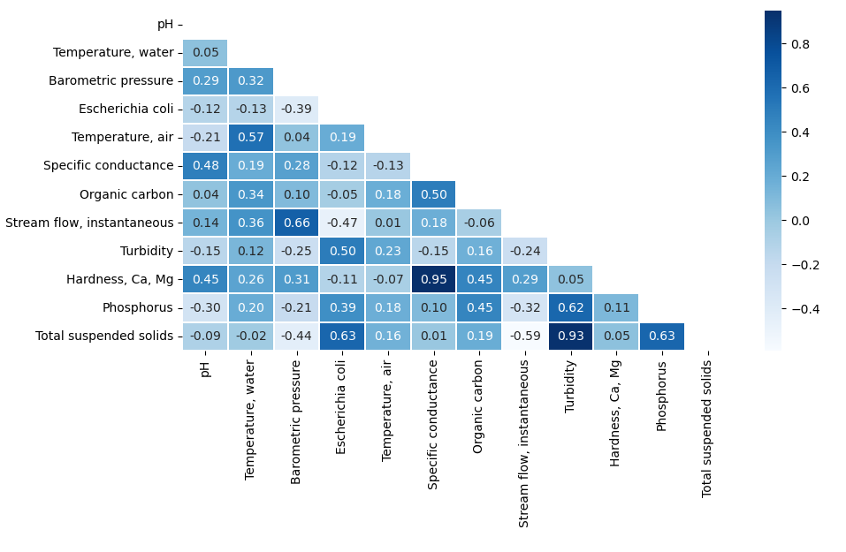
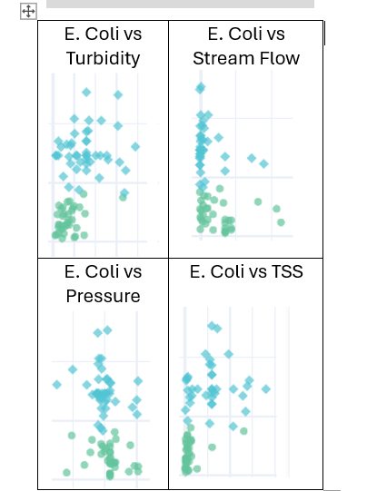
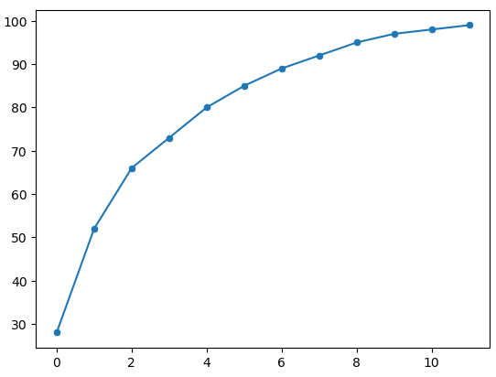
Exploratory
Data Analysis
Notes:
Using these graphs and more, I was able to narrow down my features and the sites I was going to look at

Slide 9
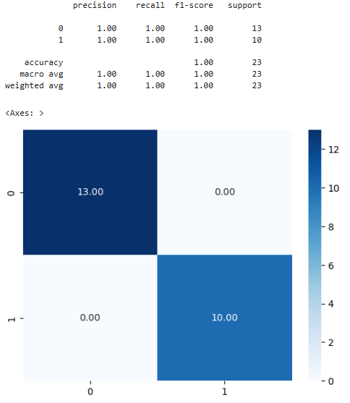
Site Selection
Model Selection
Selected 91 sites
Logistic Regression
Random Forest Classifier
XGBoost Classifier

Slide 10
Hyperparameter Tuning
Precision Increase by Model
RF: 91% to 95%
XGBoost: 88% to 95%
Voter: 96%
Grid Search Cross Validation
Notes:
When tuning my parameters, I used Grid Search Cross Validation

Slide 11
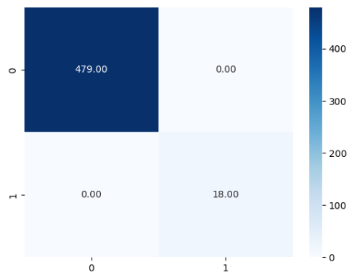
Results
Random Water Quality Dataset (496 sites)
Logistic Regression
Random Forest Classifier
XGBoost Classifier

Slide 12
Takeaways
RandomForest and XGBoost were tied as best model.
TSS measurement matter most.
A lot of features are not important (Reduced columns from 100 to 11)
Different sites have different predictability

Slide 13
Future Research
Expand to more sites
Expand to more parameters
Develop a short term model (monthly geometric mean)
Integrate physical connectivity

Slide 14
Questions?

